Slide 1
Demonstrative Adjectives
This--- that--- these--- those

Slide 2
In English, demonstrative adjectives point out people and things. They are either
SINGULAR
Julie likes this backpack.
Her mother likes that backpack.
PLURAL
We like these backpacks.
Those backpacks are too expensive.

Slide 3
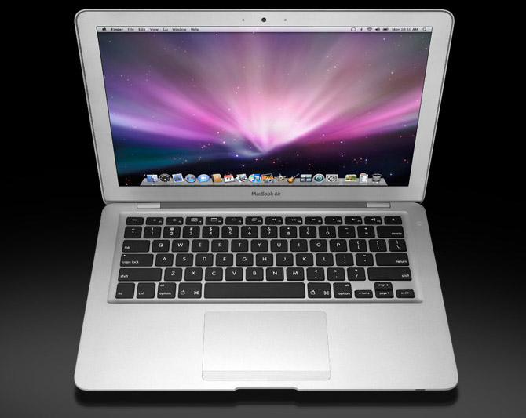
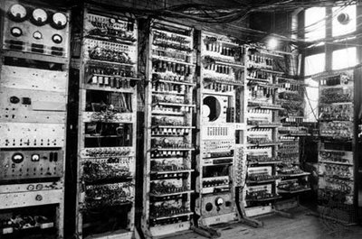
Do you like
This computer
That computer?
OR

Slide 4
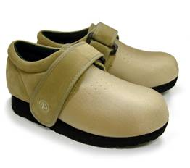
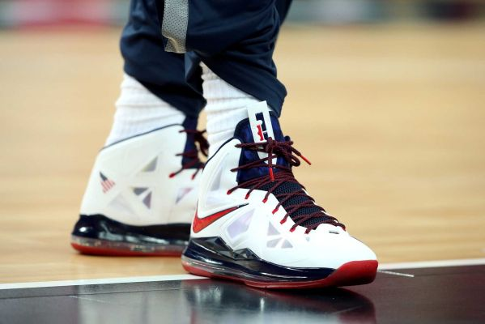
Will You Buy
These shoes
OR
Those shoes?

Slide 5
In French, Words are Masculine or Feminine
Masculine Nouns use Ce
Feminine nouns use Cette
J’aime ce film
Claudine préfère ce sac à dos.
Cette calculatrice est à Paul.
Cette glace est délicieuse.

Slide 6
Some words are also Plural and others begin with a Vowel
Plural words Use Ces
Words beginning with a vowel or silent H use cet
Ces livres sont en français.
Ces élèves sont excellents!
Nous préférons cet hôtel.
Cet élève ne parle pas français.

Slide 7
The Demonstrative adjectives in French
 | French | English
SINGULAR
Masculine | ce | this or that
Feminine | cette | this or that
Before vowel or silent h | cet | this or that
PLURAL
Masculine | ces | these or those
Feminine | ces | these or those

Slide 8
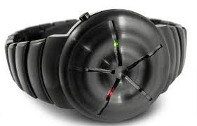
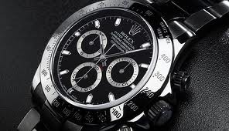
In french when we want to distinguish between two similar items, We add –ci or –là to the end of the noun.
This
that
Est-ce que tu aimes cette montre-ci?
Non, je préfère cette montre-là.

Slide 9
Maintenant c’est à toi!
Find the correct demonstrative adjective that goes in front of each noun.
ce cette cet ces
______ baskets (pl) 6. ______ jean (m)
______ pantalon (m) 7. ______ ordinateur
______ robe (f) 8. ______ après-midi
______ glace 9. ______ cravats (pl)
______ ami 10. _______ short (m)

Slide 10
Were your answers correct?
Find the correct demonstrative adjective that goes in front of each noun.
ce cette cet ces
ces baskets (pl) 6. ce jean (m)
ce pantalon (m) 7. cet ordinateur
cette robe (f) 8. cet après-midi
cette glace 9. ces cravats (pl)
cet ami 10. ce short (m)

